Slide 1
Explorations of Connections in Biomedical Research through Knowledge Graphs
CSE 4510 Big Data: Group 4

Slide 2
Project Outline
Introduction
Literature Review
Data Description
Data Cleaning and Management
Implementation
Results
Conclusions and Future Work
Methods / Proposed Approach
Notes:
Overview of our project

Slide 3
Introduction
Objective: To explore ways in which we can use knowledge graphs via Neo4J to display the biomedical concepts found within the Semantic Medline Data base and their relationship
SemMedDB : Database of automatically gathered medical literature information
Neo4J: Graphical database software to visualize a database and relationships within

Slide 4
Research Questions
How can we employ the use of knowledge and relational graphs to explore connections among concepts, treatments, and diseases discussed in various published biomedical literature?
How can the creation of these knowledge graphs be used to optimize the retrieval of information in biomedical research and the communication of complex biomedical data to the general public?

Slide 5
Literature Review
Biomedical Texts Abstracts sourced from Pub Med
Unified Medical Language System
A compilation of databases and files to enhance interpretability of biomedical concepts
Sem Rep: NLP to mine semantic relationships in text
UMLS Metathesaurus
Semantic Network
Sem Rep produces an SPO triple
{ Subject Predicate Object}
SPECIALIST Lexicon
Notes:
Talk about the background of Sem Rep and Sem Med DB

Slide 6
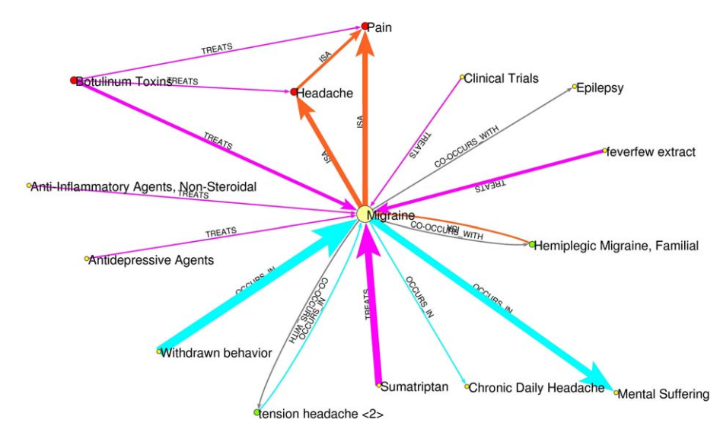
Literature Review
Previous Work : To transform the output produced from SemRep when reading in an abstract from a research article into a knowledge graph ( M. Fiszman, T. Rindflesch, H. Kilicoglu 2004).
Each node represents a biomedical entity, and the arrows represent the predication connecting the entities.
Notes:
Talk about abstraction and the use of knowledge graphs

Slide 7
Methodology & Data

Slide 8
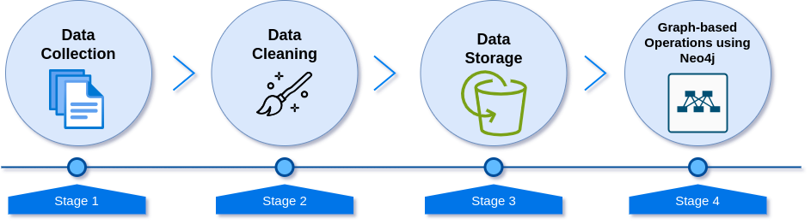
Procedural Workflow

Slide 9
Data Description
Sentence Table
Entity Table
Predication Table
Contains information about sentences from literature.
Size: 16 GB, 253,029,872 sentences
Contains details about specific entities/nouns in sentences.
Size:44 GB, 1,887,317,669 rows
Represents verbs applied to entity nouns.
Size:3 GB, 126,268,045 rows
Notes:
Sentence : Attributes include ID, PubMed identifier, type, location indexes, and the actual sentence.
Entity Table : Key attributes: ID, sentence ID, CUI identifier, name, semantic type, text mapping, character indexes, and confidence score.
Predication Table : Attributes include ID, sentence ID, PubMed ID, predicate, name, CUI, semantic type, and novelty.

Slide 10
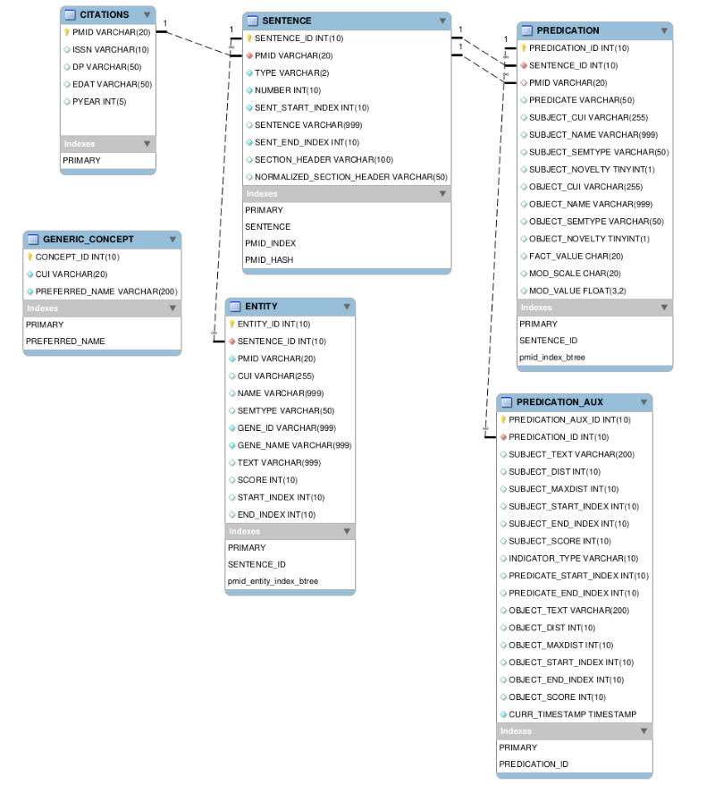
Data Description
The three data tables (Sentence, Entity and Predication) utilized in the projects are all inner joined together by their shared column “Sentence ID”.
Notes:
Sentence : Attributes include ID, PubMed identifier, type, location indexes, and the actual sentence.
Entity Table : Key attributes: ID, sentence ID, CUI identifier, name, semantic type, text mapping, character indexes, and confidence score.
Predication Table : Attributes include ID, sentence ID, PubMed ID, predicate, name, CUI, semantic type, and novelty.

Slide 11
Data Size and Reduction
Reduction methods were applied due to storage constraints.
Reasons for Reduction:
Local project limitations without server storage.
Ensuring data manageable for analysis.
Impact of Reduction:
Maintain project feasibility.
Focus on essential information.
Efficient use of resources.

Slide 12
Data Cleaning
Filled empty string and integer fields with "Not Available" and "-1", respectively.
Corrections made for database version and schema mismatch.
Identified and dropped columns with limited or unknown data (e.g., "SENT END INDEX," "NORMALIZED SECTION HEADER").
Discovered sentence data in the "SENT END INDEX" column.
Removed unnecessary columns to enhance data utility.

Slide 13
Implementation & Results

Slide 14
Relationship Building in Neo4J
Utilized the community version of Neo4J.
Main relations established via sentence foreign keys.
Predication and entity tables linked to the sentence table.
Neo4J relationships created: "SUBJECT OF" (entity to sentences) and "PREDICATES" (predication to entity).
Three one-way types of relationships formed in the overall database.

Slide 15
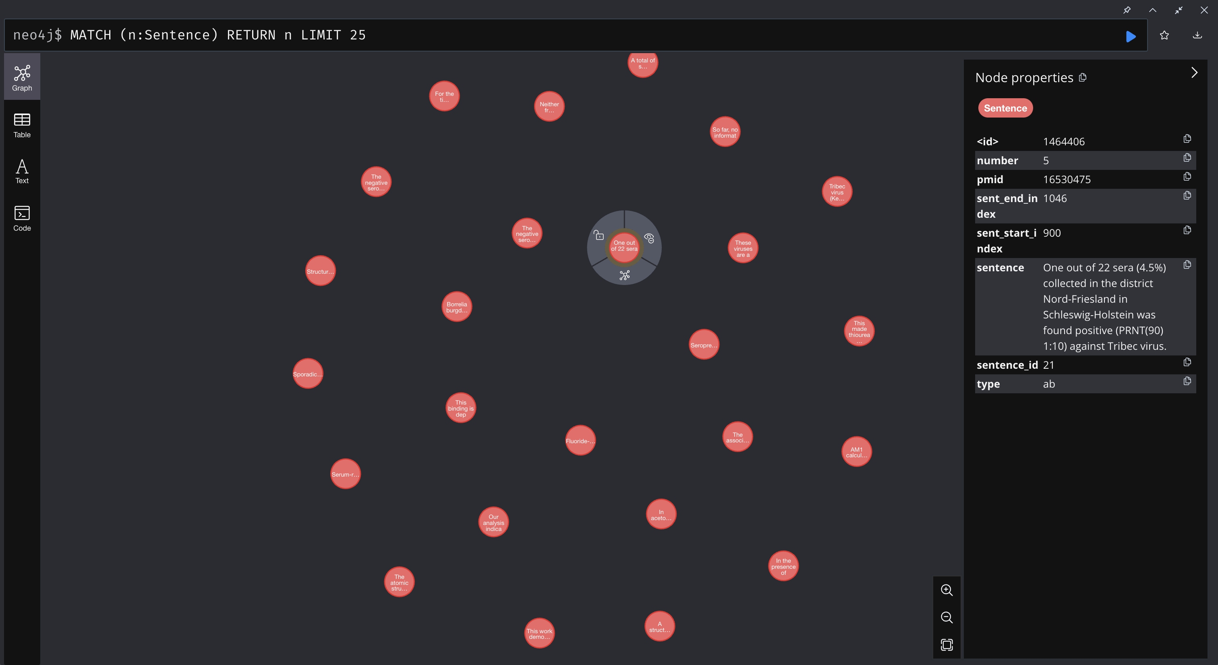
Sentence Knowledge Graph

Slide 16
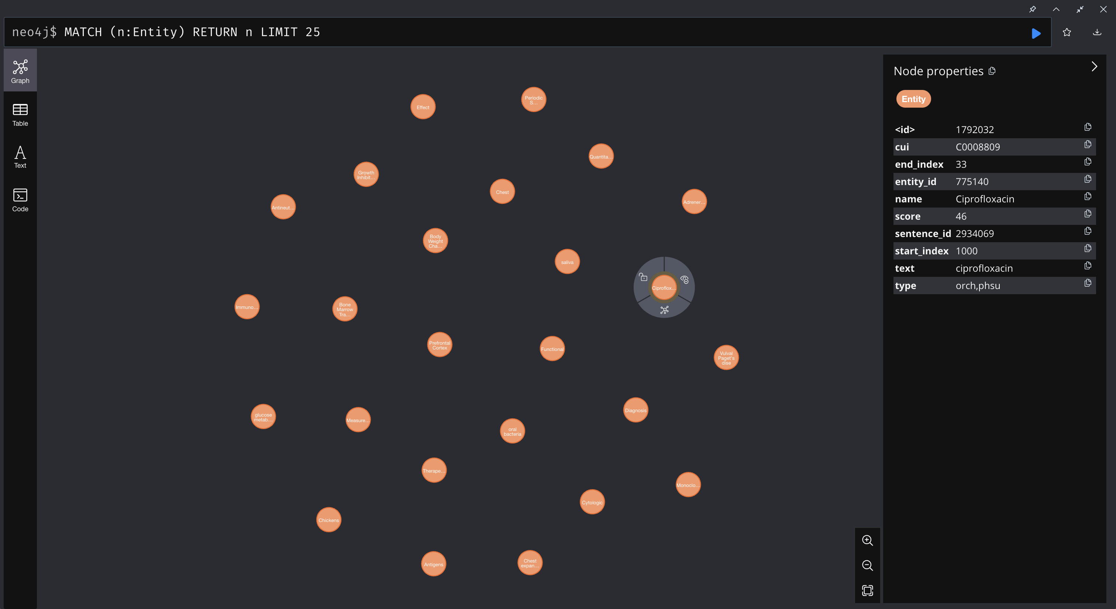
Entity Knowledge Graph

Slide 17
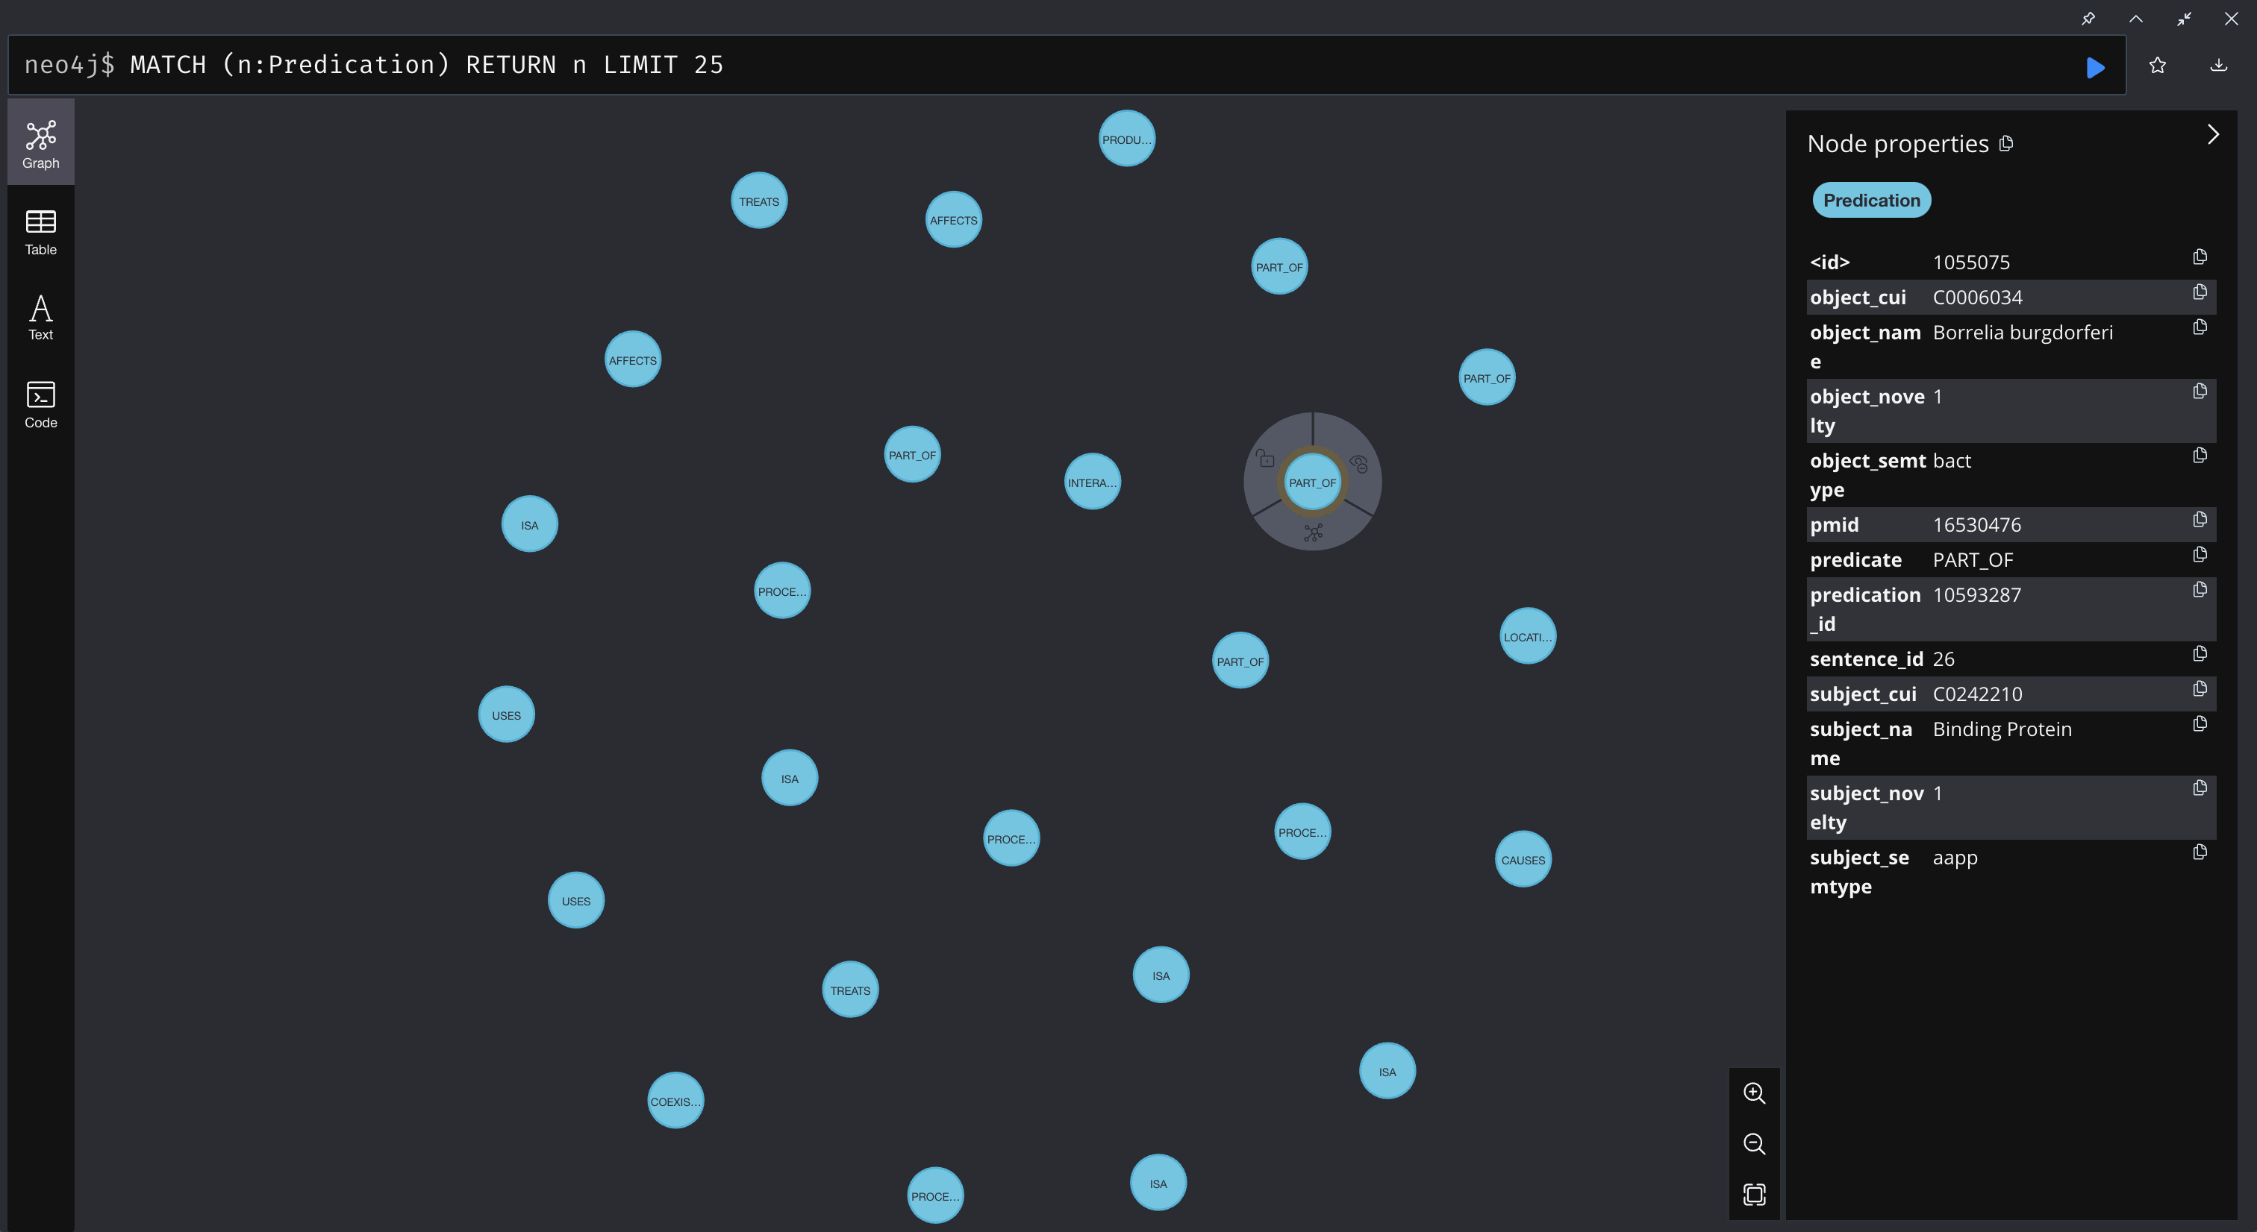
Predication Knowledge Graph

Slide 18
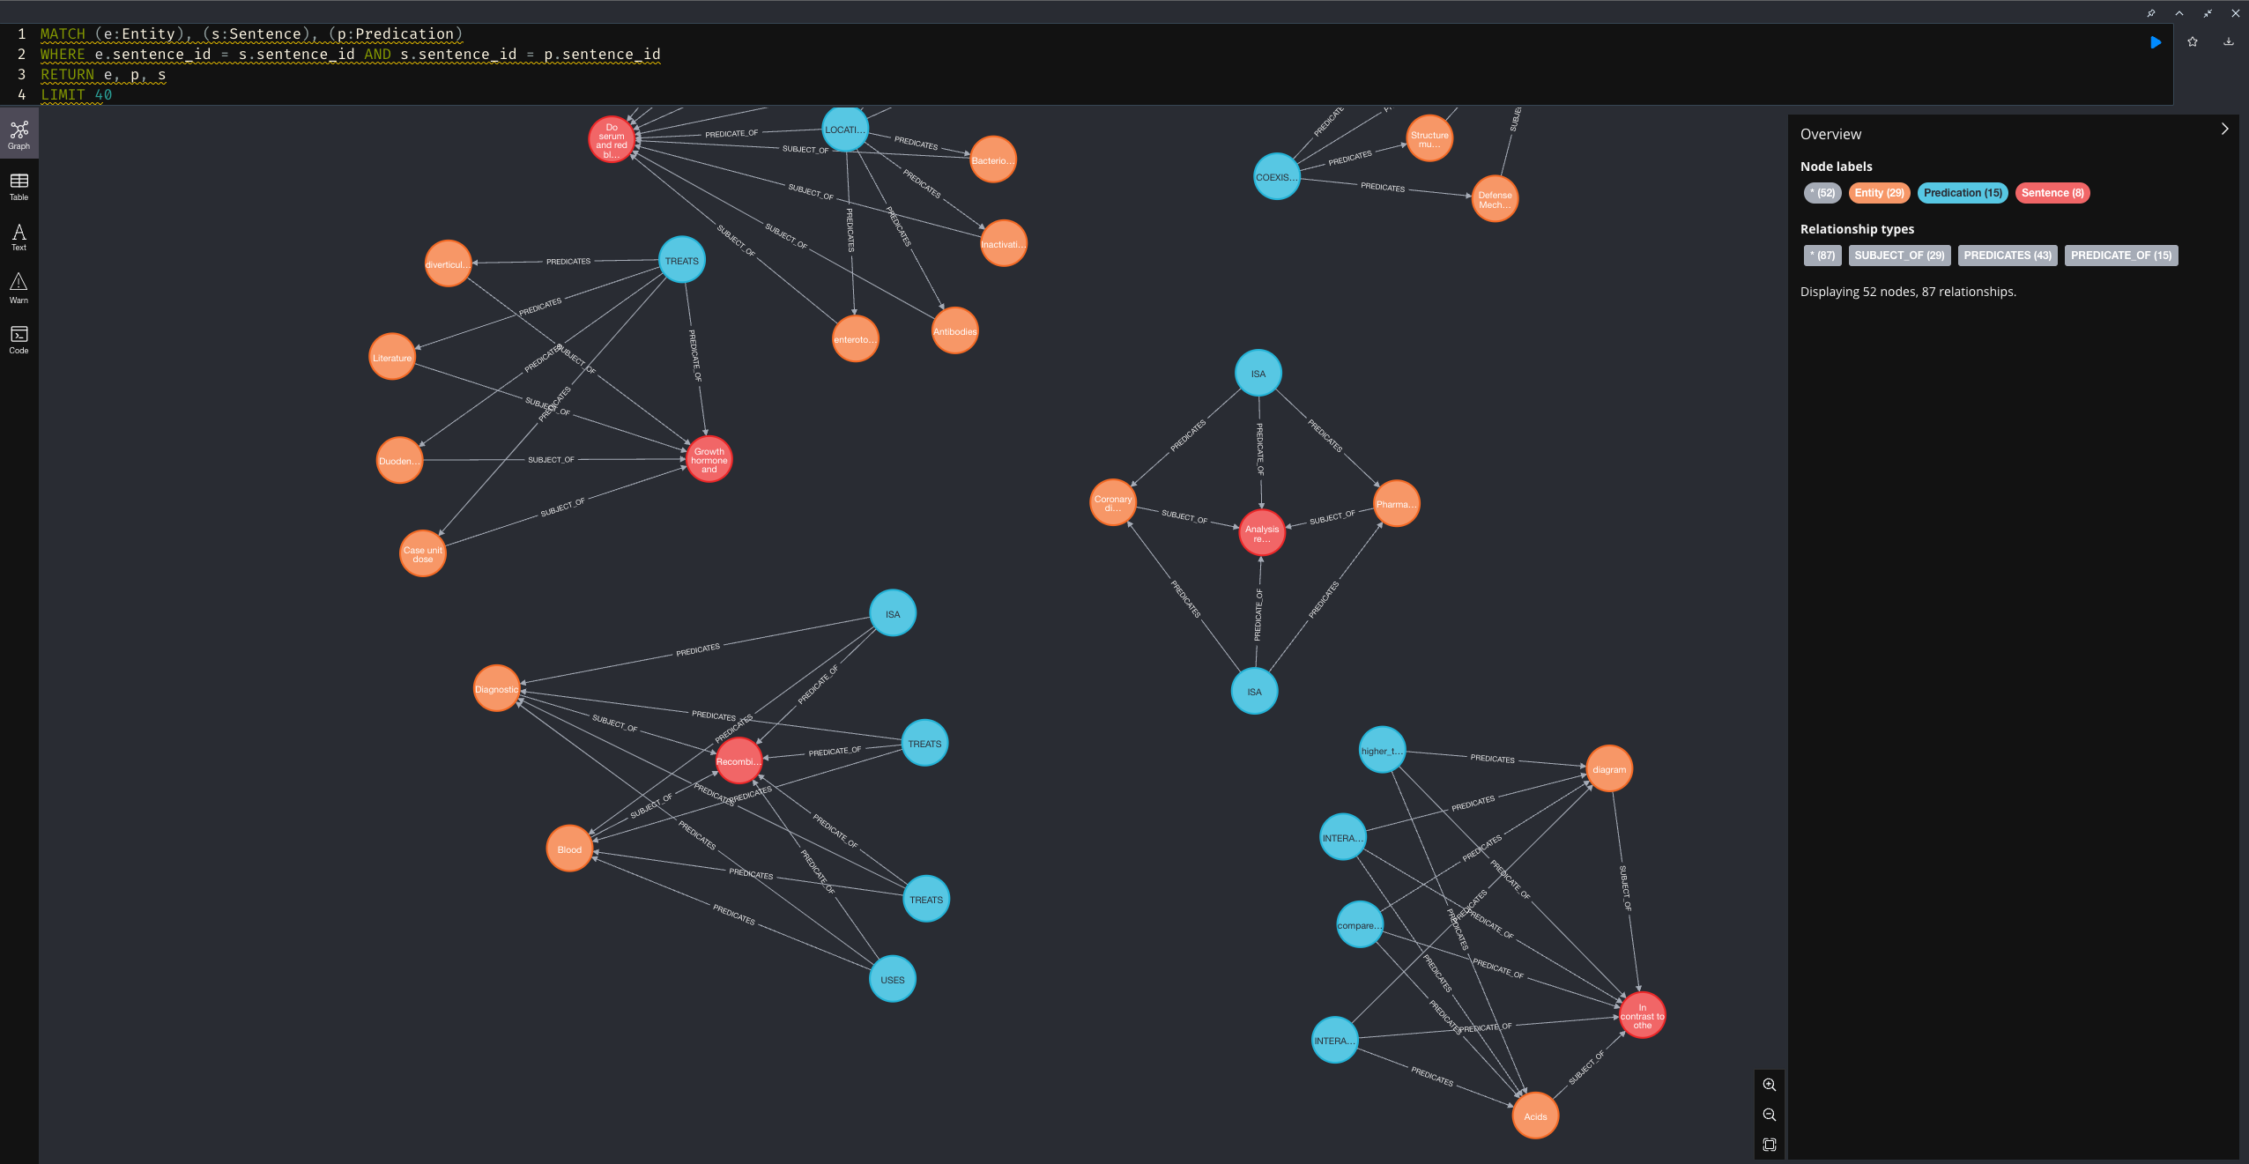
Fully Connected Knowledge Graph

Slide 19
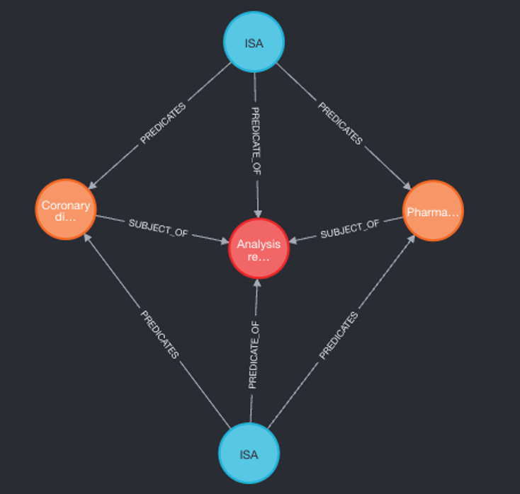
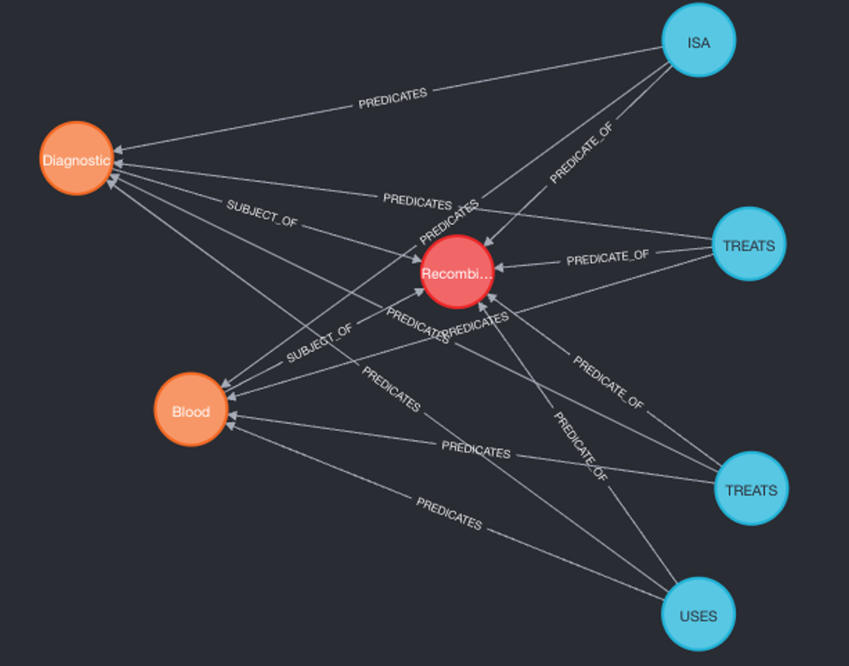
Fully Connected Knowledge Graph
Below are the fully connected graphs with the predicates connecting various biomedical subjects and objects discussed in literature.

Slide 20
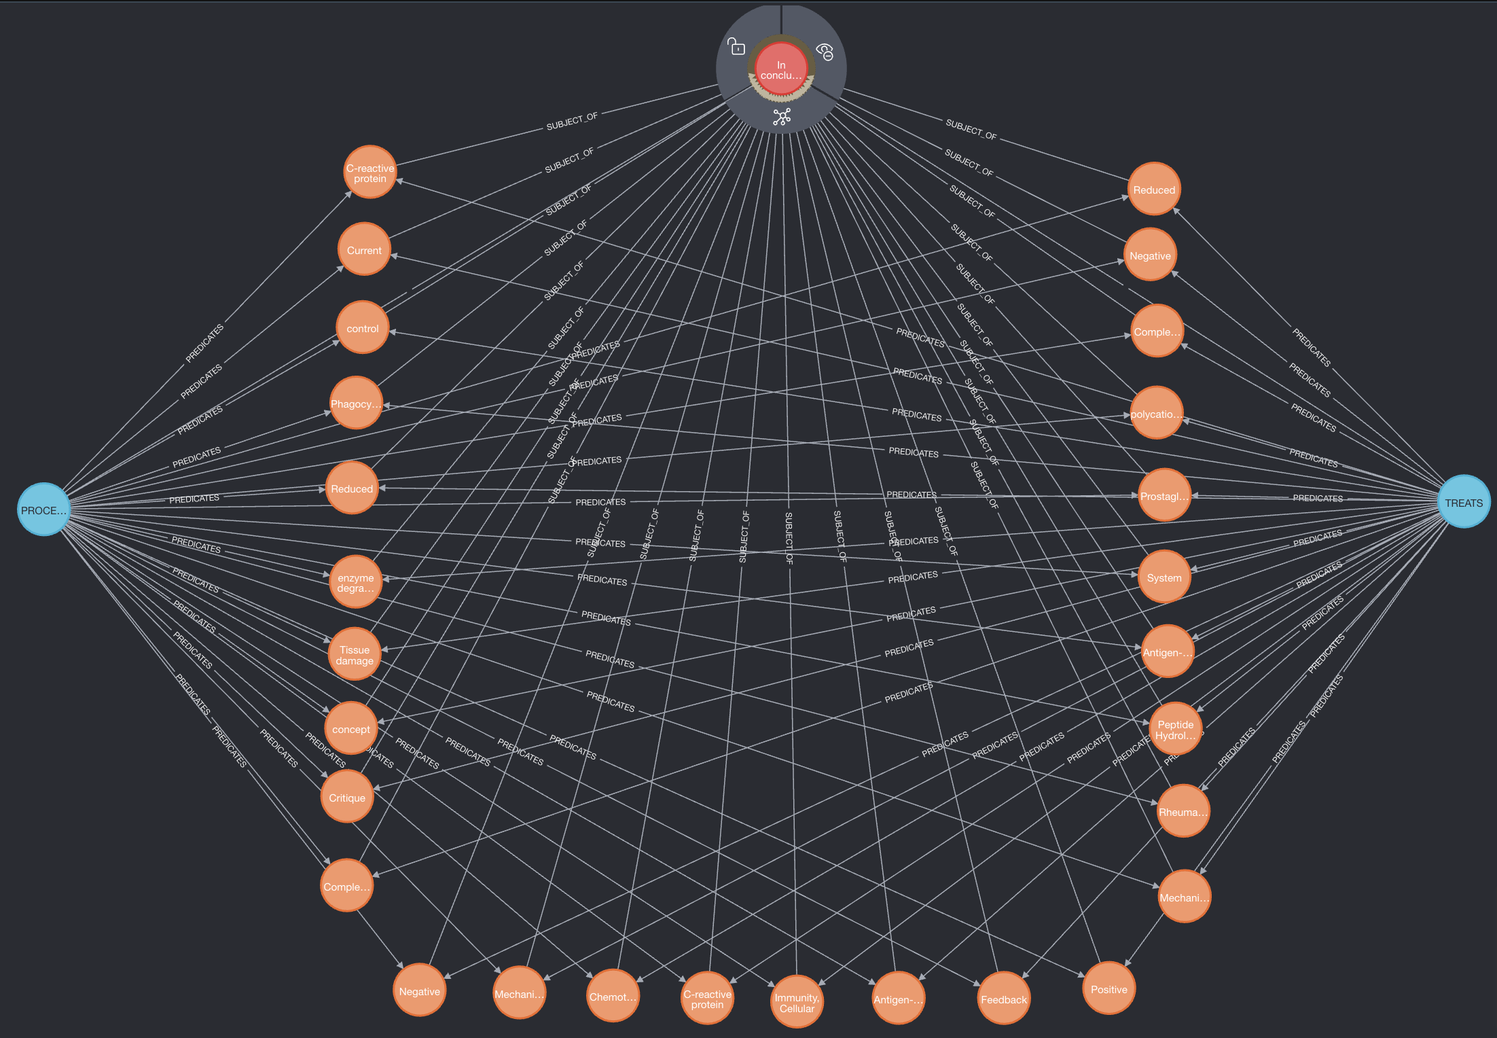
Example of a Query on the SemMed Graphical Database in Neo4j
Shows the shared connection between nodes with a subject semantic type of "hlca" or "menp".

Slide 21
Conclusion
Had to upload smaller dataset
Graph software provides powerful visualization tool for analysis and determining connections
Future Work:
Upload full database to server
Investigate using indexes to speed up computation
Web applications, API, etc

Slide 22
References
M Fiszman, T. Rindflesch, H Kilicoglu. “Abstraction Summarization for Managing the Biomedical Research Literature”. Proceedings of the HLT-NAACL Workshop on Computational Lexical Semantics (2004).
H Kilicoglu et al. “Constructing a semantic predication gold standard from the biomedical literature”. BMC Bioinformatics (2011).
A Burgun, O Bodenreider. “Comparing terms, concepts, and semantic classes in Word-Net and the Unified Medical Language System”. Proceedings of the NAACL Workshop on WordNet and Other Lexical Resources: Applications, Extensions and Customizations (2001), pp. 77–82.
A. McCray. “Representing biomedical knowledge in the UMLS Semantic Network”.High-Performance Medical Libraries: Advances in Information Management for the Virtual Era (1993), pp. 45–55.
H. Kilicoglu, G. Rosemblat, M Fiszman. “Broad-coverage biomedical relation extraction with SemRep”. BMC Bioinformatics (2020).
Y Liu et al. “Using SemRep to label semantic relations extracted from clinical text”.AMIA Annu Symp Proc (2012), pp. 587–595.
R. Graciela et al. “A methodology for extending domain coverage in SemRep”. Journal of Biomedical Informatics Vol. 46 (2013), pp. 1099–1107.
Aronson AR. 2001 Effective mapping of biomedical text to the UMLS Metathesaurus: the MetaMap program. AMIA Annu Symp Proc, pp 17-21.
National Institutes of Health. (n.d.). Unified Medical Language System (UMLS). U.S. National Library of Medicine. https://www.nlm.nih.gov/research/umls/index.html

Slide 23
Questions?

